Slide 1




Harnessing Big Data for Smarter User Recommendations in OTT Platforms
Presented By:
Ankeet Kumar
24MBMB24
MBA BA
Submitted To -
Sree Laxmi Mam
Leveraging PySpark & MLlib for User Behavior Insights

Slide 2



Dataset & Project Objectives
The Dataset
Project Objectives
The project is built on a dataset of 1,000 user records from a fictional OTT streaming service.
The primary goal was to leverage the PySpark MLlib library to derive actionable business insights.
Key Features:
Key Tasks:
•
Demographics: Age, Gender, Region
•
Perform Exploratory Data Analysis (EDA).
•
Subscription: Plan, Monthly Spend
•
Use Case 1: Predict Customer Churn.
•
Engagement: Watch Hours, Sessions
•
Use Case 2: Segment users into distinct groups.
•
Feedback: Avg. Rating, Sentiment
•
Use Case 3/4: Forecast Revenue & Watch Time.

Slide 3
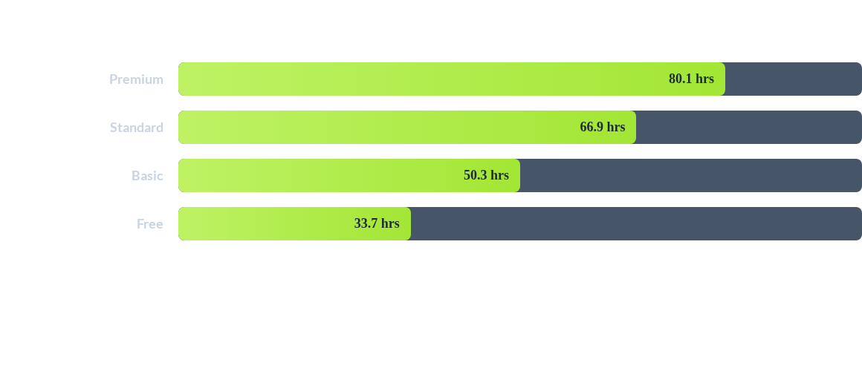
Key Insight from EDA: The "Value Ladder"
Finding: Higher subscription tiers correlate with higher engagement (Avg. Watch Hours). The 'Free' tier has a 20.4% churn rate, while the 'Premium' tier has only a 2.3% churn rate.

Slide 4

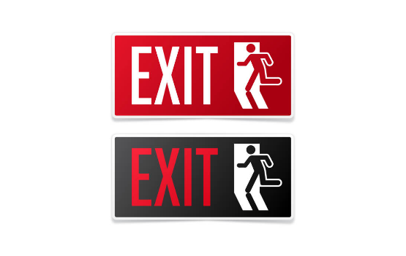
Use Case 1: Churn Prediction
Goal: Identify At-Risk Users
The first objective was to build a model that can predict which users are likely to churn (cancel their subscription).
•
Model: Random Forest Classifier.
•
Challenge: The data is highly imbalanced (913 non-churners vs. 87 churners). This means 'accuracy' is a misleading metric.
•
Key Metric: The F1-score was used, as it provides a better measure of a model's performance on imbalanced data.
•
Result: The model achieved a strong F1 score of 88.8%, indicating it is effective at correctly identifying users who are likely to churn.

Slide 5

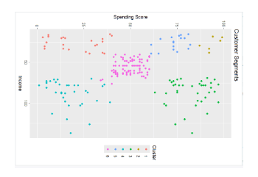
Use Case 2: User Segmentation
Goal: Group Users by Behavior
The second objective was to automatically group users into meaningful segments based on their spending and watching habits.
•
Model: Decision Tree Classifier.
•
Segments Defined:
•
Premium: High spend, high watch time.
•
Engaged Low Spender: Low spend, high watch time.
•
Low Value: Low spend, low watch time.
•
Result: The model classified users with 89.4% accuracy.
•
Actionable Insight: The **'Engaged Low Spender'** segment is a key business opportunity. These users love the content and can be targeted with upsell campaigns to convert them to higher-revenue plans.

Slide 6


Use Cases 3 & 4: Regression Analysis
Revenue Prediction (Linear Regression)
Watch Time Prediction (GBT)
A Gradient Boosted Trees model was used to predict `Total_Watch_Hours_90`.
An attempt was made to predict the specific `Monthly_Spend_USD` for a user.
Result: R-squared of -0.28
Result: R-squared of 0.09
Finding: A negative R-squared means the model performed *worse* than a simple average. This proves that predicting future watch time is highly complex and would require more advanced features (e.g., watch history, time-series data).
Finding: The model has almost no predictive power. This suggests spending is determined by the *fixed subscription plan* a user chooses, not by their watch behavior.

Slide 7
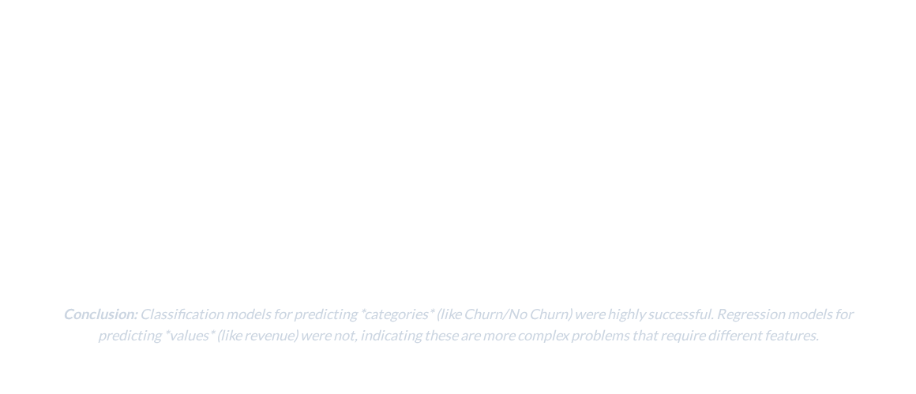
Model Comparison & Conclusion
Model Task | Model Used | Key Metric | Result
Classification | Random Forest (Churn) | F1-Score | 0.888 (Strong)
Classification | Decision Tree (Segment) | Accuracy | 0.894 (Strong)
Regression | Linear Regression (Revenue) | R-squared | 0.093 (Poor)
Regression | GBT Regressor (Watch Time) | R-squared | -0.286 (Poor)

Slide 8
THANK YOU

